Slide 1
Naive Bayes Classifier
Presented By
Hetvi Shah
Heet Trivedi
Ramya Surati
Instructor: Dr. Yasser Alginahi
October 20th, 2023

Slide 2
Agenda
Introduction to Naive Bayes Classifier
Bayes’ Theorem
Conditional Probability
Types of Naive Bayes Classifier
Limitations
Real Life Examples
Code Implementation

Slide 3
Hierarchy of Machine Learning Algorithms
Machine Learning
Supervised Learning
Unsupervised Learning
Classification
Regression
Naive Bayes Classifier
Support Vector
Machine

Slide 4
Introduction
A classification algorithm in machine learning and statistics
Used to estimate the probability of an input belonging to a particular category or class based on Bayes’ Theorem
“Naive” assumption in Naive Bayes is about features being conditionally independent
Calculates the probability of each class and then pick the one with the highest probability
Based on Conditional Probability concept

Slide 5
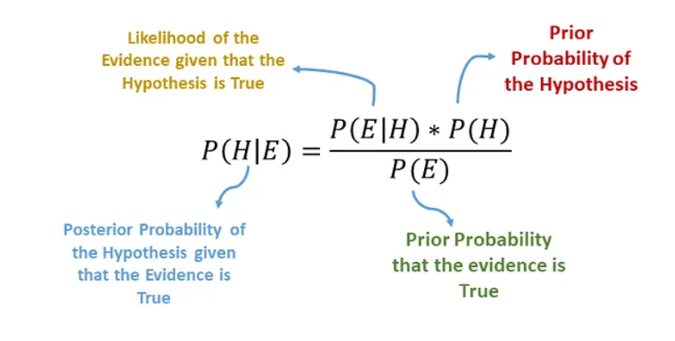
Bayes’ Theorem
Theorem for Conditional Probability
Source: https://tinyurl.com/ye5b8cw8

Slide 6

What is Conditional Probability ?
Probability of an event occurring given that another event has already occurred
Quantifies the likelihood of an event happening under a specific condition
The probability of event A given probability of event B, which is denoted by

Slide 7
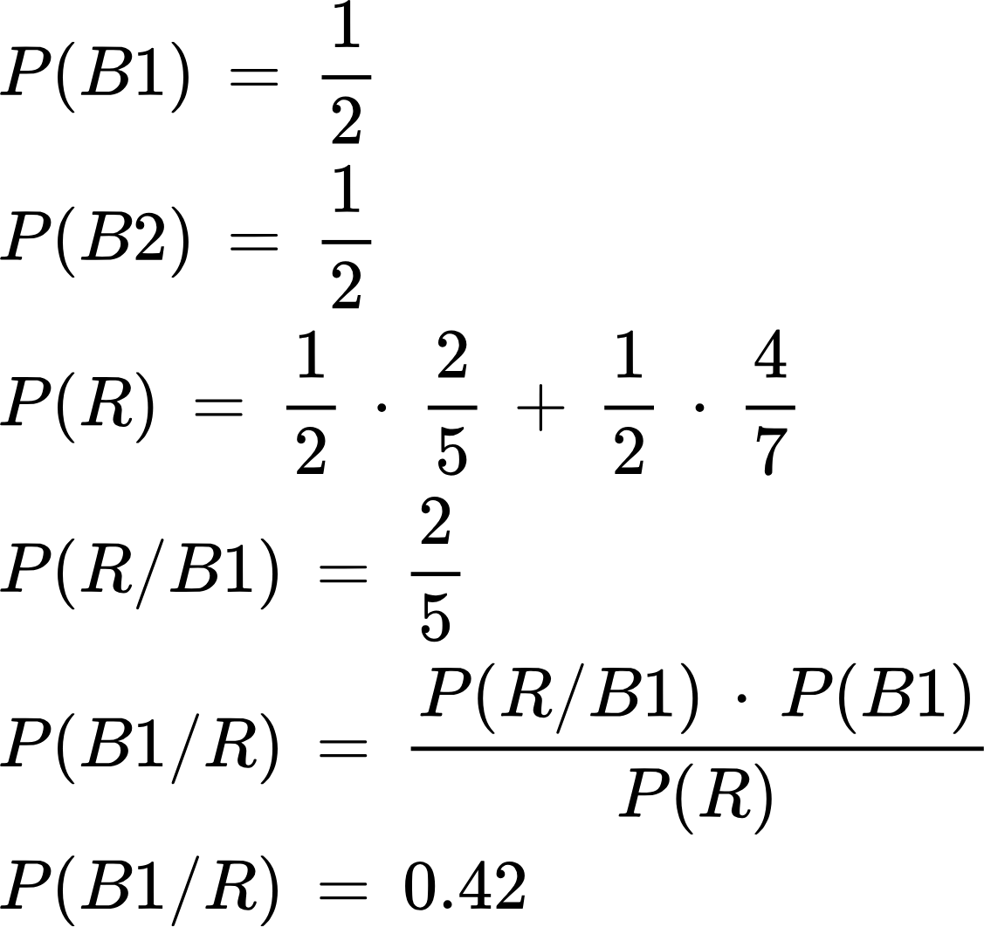
Example of Conditional Probability
Bag 1 (B1)
2 Red (R)
3 Black (B)
Bag 2 (B2)
4 Red (R)
3 Black (B)

Slide 8

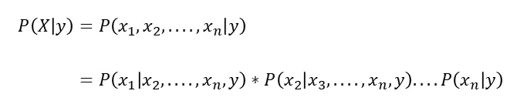
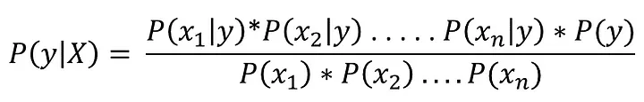
Chain Rule
We can breakdown P(X|y) as:
So,

Slide 9
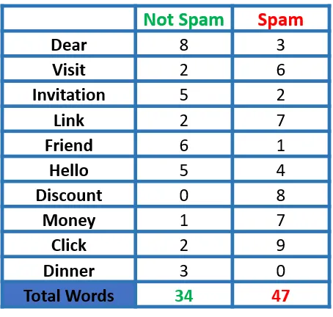
Spam Email Detection
Table: Frequency of Words for Spam Detection
Given: Number of Not Spam emails= 15
&
Number of Spam emails= 10
Examining various possibilities:
P(Dear|Not spam) = 8/34
P(Visit|Not spam) = 2/34
P(Dear|Spam) = 3/47
P(Visit|Spam) = 6/47
Source: https://tinyurl.com/4c7kmwf9

Slide 10
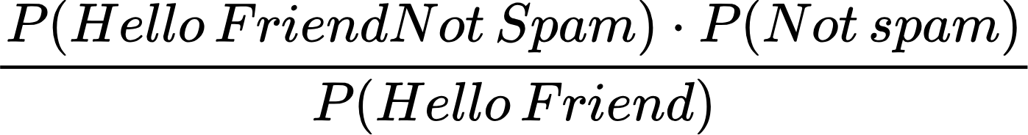
Spam Email Detection
P(Not spam|Hello friend)=
Ignoring the denominator,
P(Not spam|Hello friend)=P(Hello Friend|Not spam)* P(Not spam)
Technically, P(Not spam|Hello friend) should be 0, as this case (Hello friend does not exist in the dataset. We consider single words and the not complete sentences.
Here’s when Naive Bayes comes into picture which assumes that the features that we use to predict the target are independent.

Slide 11
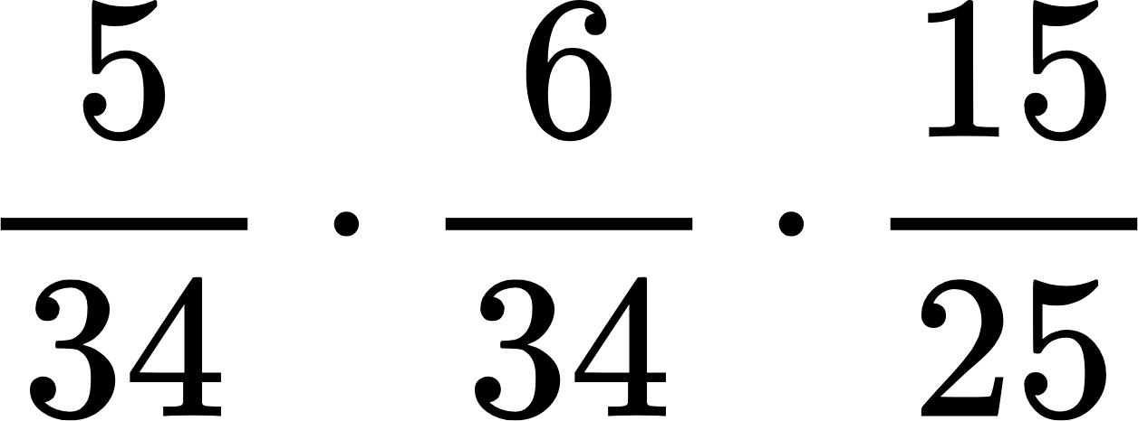
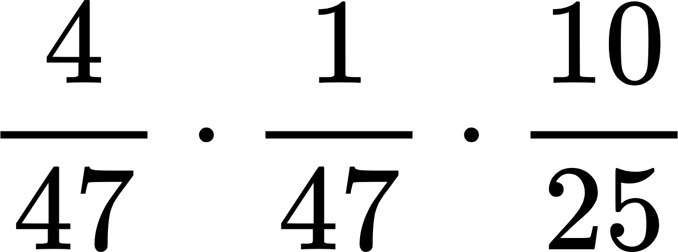
Spam Email Detection
-Probability of Hello Friend being Not Spam:
P(Not spam|Hello friend)=P(Hello|Not spam)*P(Friend|Not spam)* P(Not spam)
P(Not spam|Hello friend)= = 0.0155
-Probability of Hello Friend being Spam:
P(Spam|Hello friend)=P(Hello|Spam)*P(Friend|Spam)* P(Spam)
P(Spam|Hello friend)= = 0.00072
Therefore, the message “Hello Friend” is NOT SPAM.

Slide 12
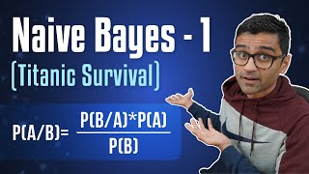
Youtube Video
This video provides an explanation of the fundamental principles behind Naive Bayes’ Algorithm.

Slide 13
Types of Classifier in Naives
Multinomial Naive Bayes
Uses Multinomial distribution (“n” values possible) of each feature i.e. discrete / count data.
Bernoulli Naive Bayes
Features having binary attributes.

Slide 14
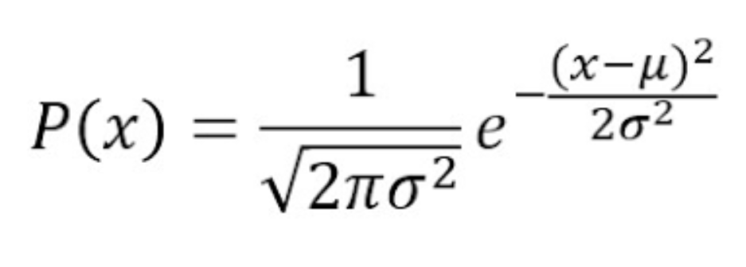
Types of Classifier in Naives
Gaussian Naive Bayes
Features follow Gaussian Distribution i.e. features are continuous and assumed that they are distributed normally.
The conditional probability is given by :
Formula for Normal Distribution
Here,
μ - mean of the feature
σ - standard deviation of the feature
Source: https://tinyurl.com/3fbrww4m

Slide 15
Limitations
Independence Assumption
Imbalanced Dataset
Zero Frequency Problem

Slide 16
Zero Frequency Problem
Suppose some event is not there in our example then the model will assign zero probability for that event and also, any set of unseen events [5].
And when all the possibilities are multiplied, we will have a zero.
Example : Spam Detection

Slide 17
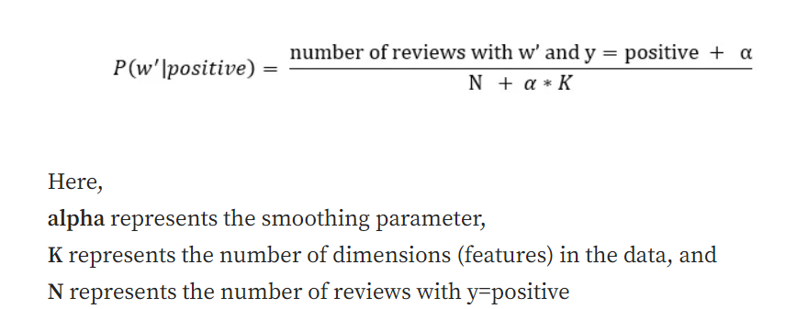
Solution to Zero Frequency Problem
Laplace Smoothing for Feature (w’)
Source: https://tinyurl.com/h56rtzcx

Slide 18
Real Life Applications
Email Spam Detection
Weather Forecast
Sentiment Analysis
News Article Classification
Credit Scoring

Slide 19
Dataset and Code Implementation
Training Dataset: Spam.csv
Here the data set contains 2 columns which are “category” and “message”.
The column “category” contains values such as “Ham” and “Spam” to classify the email type whereas the column “message” contains the email body.
Jupyter Notebook: Implementation of Multinomial naive Bayes Classifier for Email Spam Detection

Slide 20
Code
import pandas as pd
df = pd.read_csv("spam.csv")
df.groupby('Category').describe()
df['spam']=df['Category'].apply(lambda x: 1 if x=='spam' else 0)
df.head()
Here, first we will load the dataset and explore the dataset through describe function to understand spam and ham emails with the help of Pandas library.
Then by using the lambda function we will add a column called spam to classify the email category.

Slide 21
Code
from sklearn.model_selection import train_test_split
X_train, X_test, y_train, y_test = train_test_split(df.Message,df.spam ,testsize=0.25)
from sklearn.feature_extraction.text import CountVectorizer
v = CountVectorizer()
X_train_count = v.fit_transform(X_train.values)
X_train_count.toarray()[:2]
from sklearn.naive_bayes import MultinomialNB
model = MultinomialNB()
model.fit(X_train_count,y_train)
Here, we are splitting the data into training set (75%) and test set (25%) and by the help of Count Vectorizer we are turning the text body into the frequency table.
Later, we are using the Multinomial Naïve Bayes classifier to train our model.

Slide 22
Code
emails = [ 'Hey mohan, can we get together to watch footbal game tomorrow?',
'Upto 20% discount on parking, exclusive offer just for you. Dont miss this reward!’]
emails_count = v.transform(emails)
model.predict(emails_count)
X_test_count = v.transform(X_test)
model.score(X_test_count, y_test)
Here, we are taking the sample test email to understand the working of our model.
First, we need to the transform the email body into a count using the transform() of Count Vectorizer and then we will that transformed data into our model to predict the category of the email.
Moreover, we can use the pipeline to reduce the steps of transformation.

Slide 23
References
[1] B. Gamal, “Naïve Bayes Algorithm,” Analytics Vidhya, Apr. 11, 2021. https://medium.com/analytics-vidhya/na%C3%AFve-bayes-algorithm-5bf31e9032a2
[2] A. A. Awan and A. Navlani, “Naive Bayes classifier tutorial: With Python Scikit-Learn,” DataCamp, https://www.datacamp.com/tutorial/naive-bayes-scikit-learn
[3] L. S, “Gaussian naive Bayes algorithm for credit risk modelling,” Analytics Vidhya, https://www.analyticsvidhya.com/blog/2022/03/gaussian-naive-bayes-algorithm-for-credit-risk-modelling/
[4] R. Gandhi, “Naive Bayes classifier,” Medium, https://towardsdatascience.com/naive-bayes-classifier-81d512f50a7c
[5] “Naïve Bayes Algorithm: Everything you need to know,” KDnuggets, https://www.kdnuggets.com/2020/06/naive-bayes-algorithm-everything.html
‌

Slide 24
Thank you

